Slide 1
Programming Logic and Design Tenth Edition
Chapter 1
An Overview of Computers and
Programming

Slide 2
Objectives
In this chapter, you will learn about:
Computer systems
Simple program logic
The steps involved in the program development cycle
Pseudocode statements and flowchart symbols
Using a sentinel value to end a program
Programming and user environments
The evolution of programming models

Slide 3
Understanding Computer Systems
Computer system
Combination of all the components required to process and store data using a computer
Hardware
Physical equipments associated with a computer
Software
Computer instructions that tells the hardware what to do
Programs
Instructions written by programmers
Programming
Writing software instructions

Slide 4
Understanding Computer Systems (continued -1)
Computer hardware and software accomplish three major operations:
Input
Data items such as text, numbers, images, and sound
Processing
Calculations and comparisons performed by the central processing unit (CPU)
Output
Resulting information that is sent to a printer, a monitor, or storage devices after processing
A cloud based device is accessed through the Internet

Slide 5
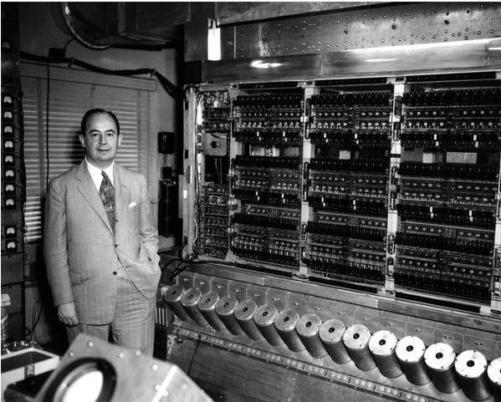
Von Neumann Architecture
Prior to von Neumann
Computers were built for specific tasks
Programs were hard-wired into the computer
You had to either build a new computer or rewire the existing one to change the program
John von Neumann
Hungarian-American mathematician and physicist
Member of the Manhattan Project
Interested in how to build a general-purpose computer

Slide 6
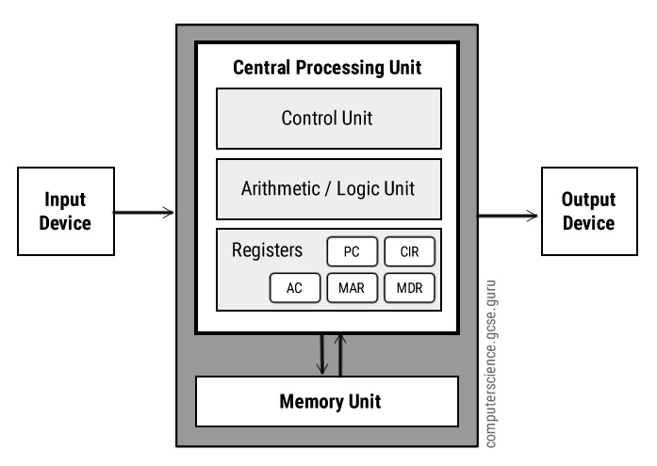
Von Neumann Architecture (Cont_1)
Input/Output (I/O)
Devices that allow the computer to interact with the outside world
Examples:
IN: keyboards, mice, touchscreens, file storage (load a file, e.g. a program)
OUT: monitors, speakers, printers, file storage (write to a file)

Slide 7
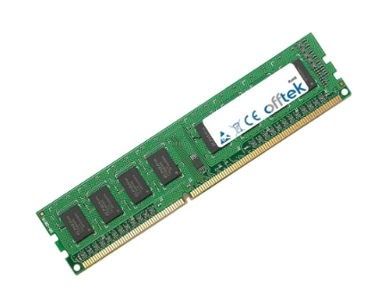
Von Neumann Architecture (Cont_2)
Memory (primary or main memory)
Stores data and instructions that the CPU needs to operate
Today if you hear the word "memory" we are referring to RAM. We call hard drives "storage" or "secondary storage".

Slide 8
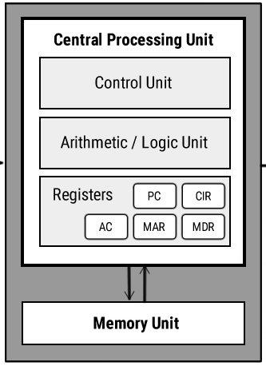
Von Neumann Architecture (Cont_3)
Central Processing Unit (CPU)
The "brain" of the computer
Where instructions are executed
Has three main components:
Control Unit
Arithmetic Logic Unit (ALU)
Registers

Slide 9
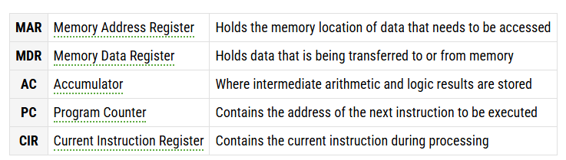

Von Neumann Architecture (Cont_4)
Registers
Small amount of storage on the CPU itself
Extremely fast because of proximity to CPU components
Every operation in the CPU involves fast moving data to and from registers

Slide 10
Von Neumann Architecture (Cont_5)
Control Unit
"Manager" of the CPU
Manages the flow of data and instructions within the computer
Arithmetic Logic Unit (ALU)
"Worker" of the CPU
Performs arithmetic and logical operations
Arithmetic: addition, subtraction, multiplication, division
Logical: AND, OR, NOT, XOR
Comparison: greater than, less than, equal to

Slide 11
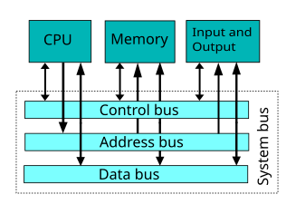
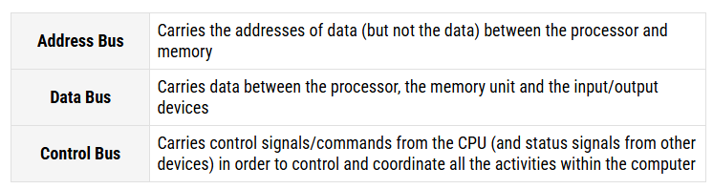
Von Neumann Architecture (Cont_6)
Buses
Buses are the means by which data is transmitted from one part of a computer to another, connecting all major internal components to the CPU and memory.
A standard CPU system bus is comprised of a control bus, data bus and address bus.

Slide 12
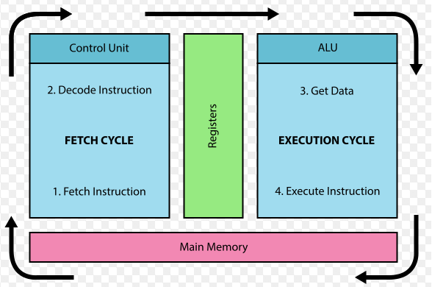
Von Neumann Architecture (Cont_7)
Fetch Decode Execute Cycle (Instruction cycle)
Fetch:
Move the instruction from memory to a special instruction register in the CPU.
This instruction is determined by the value in the program counter register.
The program counter is then incremented so that the next instruction can be fetched.
Decode:
The control unit reads the instruction and determines what to do.
It preps the ALU and other components for the operation that will come next.
Execute:
The ALU performs the operation on the data in the registers.
The intermediate result is stored in a special register called the accumulator.

Slide 13
Basic Units of Memory
1 bit (0 or 1)
1 byte normally consists of 8 bits
Is the storage for one character
2¹⁰ bytes =1024 bytes = 1 kilobyte (KB)
1024 KB = 1 megabyte (MB)
1024 MB = 1 gigabyte (GB)
Many people approximate in steps of 1000, not 1024
Example: a 20KB file actually has 20,480 bytes, not 20,000 bytes

Slide 14
Mass Storage Devices
Magnetic storage (HDD)
Hard disks are always internal but external hard disks may be added as supplemental storage
Optical storage
CDs and DVDs
Solid-state storage (SSD)
Flash drives
Cloud Computing
Delivers computer services over the Internet with a host that provides service:
Infrastructure (hardware, servers, networking)
Platform (rent hardware, operating systems, storage, networking capacity)
Software (use software applications for a fee)

Slide 15
Software
Application Software
enhances productivity
solves problems
supplies information
provides entertainment
examples: word processors, database managers, spreadsheets, photo editors, browsers
System Software: The Operating System, Firmware..
controls and maintains hardware
communicates with user
manages and communicates with applications
examples: Windows, DOS, Linux, UNIX

Slide 16
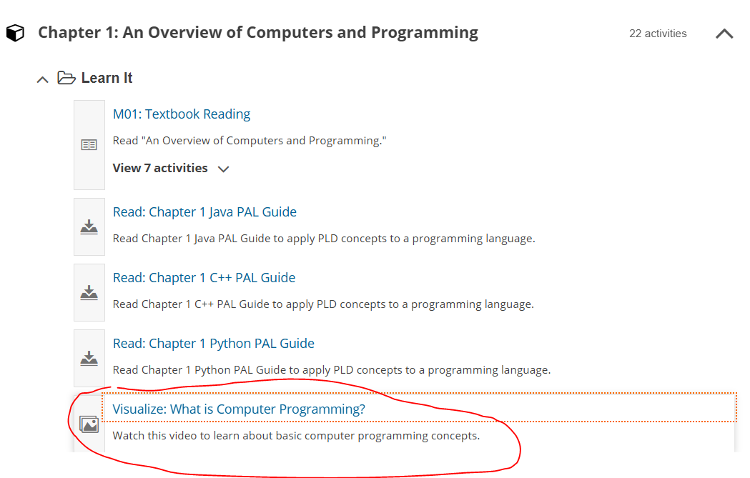
What is computer programming?

Slide 17
Programming and Scripting Languages
Low-level Languages
Machine Languages
Consists only of sequences of 0s and 1s
example:
0110110111110111 0000000100000000 0000000100000000
Assembly Languages
symbolic representation of machine language
example: ADD A,B
High-level Languages
contains English words and phrases and algebraic expressions
easier to learn and use, and the resulting programs are easier to read and modify
examples of high level languages:
C++ Objective C
COBOL Java
JavaScript Visual Basic
What are pros and cons of Low-Level and High-Level Languages?

Slide 18
Understanding Computer Systems (continued -2)
Programming language
Used to write computer instructions called program code
Writing instructions is called coding the program
Examples
Visual Basic, C#, C++, or Java
Syntax
Rules governing word usage and punctuation
Mistakes in a language’s usage are syntax errors

Slide 19
Understanding Computer Systems (continued -3)
Compiler or interpreter
Translates source code into machine language (binary language) statements called object code
Checks for syntax errors
Program executes or runs
Input will be accepted, some processing will occur, and results will be output

Slide 20
Understanding the Program Development Cycle
Program development cycle
Understand the problem
Plan the logic
Code the program
Use software (a compiler or interpreter) to translate the program into machine language
Test the program
Put the program into production
Maintain the program

Slide 21
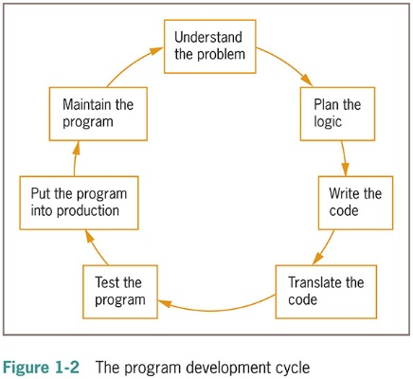
Understanding the Program Development Cycle (continued -1)

Slide 22
Understanding the Program Development Cycle (continued -2)
Program: Make me some cookies

Slide 23
Understanding the Problem
One of the most difficult aspects of programming
Users or end users
People for whom a program is written
Documentation
All supporting paperwork for a program

Slide 24
Planning the Logic
Plan the steps of the program and what they include
An algorithm is the sequence of steps or rules you follow to solve a problem
Most common planning tools
Flowcharts
Pseudocode
Desk-checking
Walking through a program’s logic on paper before you actually write the program

Slide 25
Coding the Program
Hundreds of programming languages available
Choose based on features
Similar in their basic capabilities
Coding is easier than the planning step
Experienced programmers can successfully combine logic planning and program coding in one step

Slide 26
Using Software to Translate the Program into Machine Language
Translator program
Compiler or interpreter
Changes the programmer’s English-like high-level programming language into the low-level machine language
Syntax error
Misuse of a language’s grammar rules
Programmer corrects listed syntax errors
Might need to recompile the code several times

Slide 27
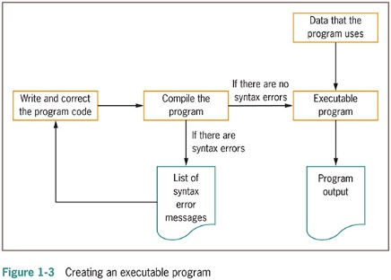
Using Software to Translate the Program into Machine Language (continued -1)

Slide 28
Testing the Program
Logical error
Results when a syntactically correct statement, but the wrong one for the current context, is used
Test
Execute the program with some sample data to see whether the results are logically correct
Debugging is the process of finding and correcting program errors
Programs should be tested with many sets of data

Slide 29
Putting the Program into Production
Process depends on program’s purpose
May take several months
Conversion
The entire set of actions an organization must take to switch over to using a new program or set of programs

Slide 30
Maintaining the Program
Maintenance
Making changes after the program is put into production
Common first programming job
Maintaining previously written programs
Make changes to existing programs
Repeat the development cycle

Slide 31
Understand the 3 basic elements of every program
There are 3 basic elements in every program. They are:
Input: Getting input from users or from files, database…
Processing: Everything with calculations, formulas, assignments
Output: Giving out the desired outputs
For example:
A program that prompts users to enter a number, calculates its double, and then displays the result. What are inputs, outputs? How do you do with processing, assignment?
A program that prompts users to enter the length and the height of a rectangle, calculates its area, and then displays the result. What are inputs, outputs? How do you do with processing, assignment?

Slide 32
Working with Variables
Variable are named memory locations
Contents can vary or differ over time
Variable names are case sensitive
Variable names:
Must be one word
Must start with a letter
Should have some appropriate meaning

Slide 33
Operators
Operators are symbols that perform operations on values.
Assignment operator =
Arithmetic operators: +, -, *, /, //, %, **
Comparison operators: ==, !=, <, >, <=, >=
Logical operators: and, or, not

Slide 34
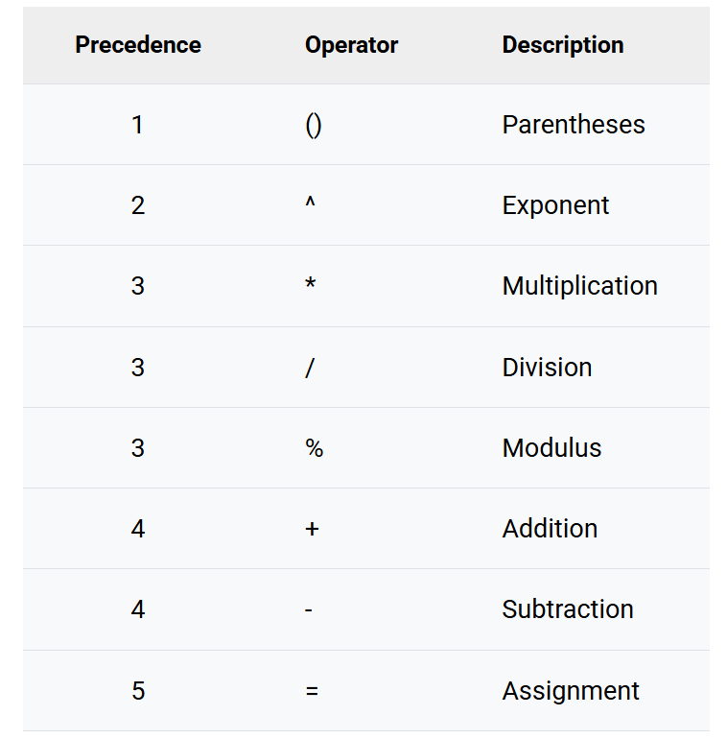
Arithmetic Order of Operations
Find x= (32 / 4 + 12) / 5 - 9 % 2

Slide 35
Understanding Simple Program Logic
Programs with syntax errors cannot execute
Syntax: the specific rules and structure
Each programming language has its own syntax.
Logical errors
Errors in program logic produce incorrect output
Logic of the computer program
Sequence of specific instructions in specific order
Variable
Named memory location whose value can vary

Slide 36
Using Pseudocode Statements and Flowchart Symbols
Pseudocode
English-like representation of the logical steps it takes to solve a problem
Flowchart
Pictorial representation of the logical steps it takes to solve a problem

Slide 37
Writing Pseudocode
Pseudocode representation of a number-doubling problem
start
Input myNumber
myAnswer = myNumber * 2
Output myAnswer
stop

Slide 38
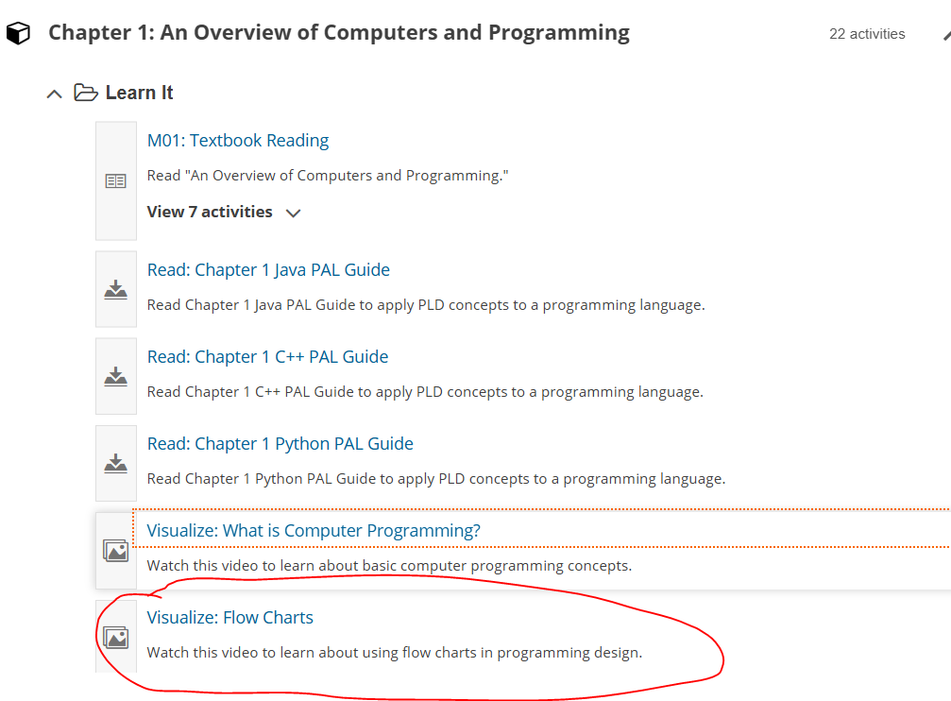
Drawing Flowcharts

Slide 39


Drawing Flowcharts
Create a flowchart
Draw geometric shapes that contain the individual statements
Connect shapes with arrows
Terminal symbols
Start/stop symbols
Shaped like a racetrack
Also called lozenges

Slide 40
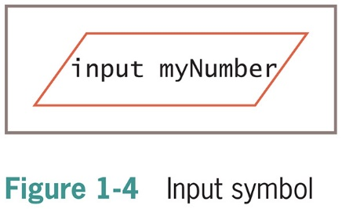
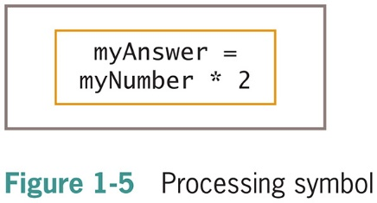
Drawing Flowcharts (Cont_1)
Input symbol
Indicates input operation
Parallelogram
Processing symbol
Contains processing statements such as arithmetic
Rectangle

Slide 41
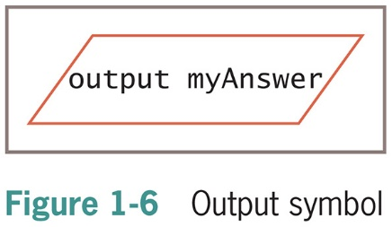
Drawing Flowcharts (Cont_2)
Output symbol
Represents output statements
Parallelogram
Flowlines
Arrows that connect steps

Slide 42
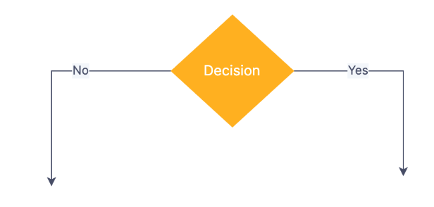
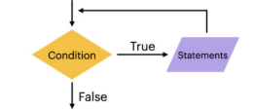
Drawing Flowcharts (Cont_3)
Making Decision
While Loop

Slide 43
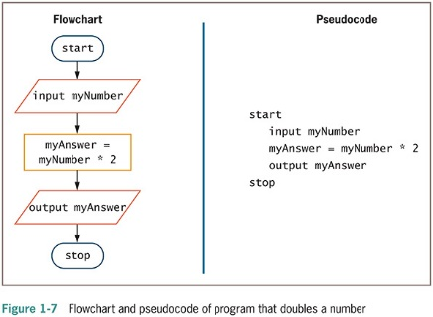

Pseudo Code and Flowchart
They are not good programs. A good program should include, but is not limited to, the following:
+ Header comment: Explain the purpose of the program.
+ Meaningful prompts: Clearly instruct users on what actions to take.
+ Meaningful output: Display informative and relevant text in the outputs.+very confusing

Slide 44
Using header comment, meaningful prompts and outputs
Add header comment, meaningful prompts, outputs
// This program will ask user to enter a number and the printout double of that number
Start
Output(“Enter a number: ”)
Input Mynumber
Myanswer = Mynumber*2
Output(“My answer is “, Myanswer)
Stop
Header comment
Prompt
Meaningful output

Slide 45
Using header comment, meaningful prompts and outputs (Cont_1)
Add header comment, meaningful prompts, outputs
// This program will ask user to enter a number and the printout double of that number
Start
Output(“Enter a number: ”)
Input Mynumber
Myanswer = Mynumber*2
Output(“My answer is “, Myanswer)
Stop
Header comment
Prompt
Draw a hierarchy chart for this program
Meaningful output

Slide 46
Making Decision
Eligible to vote when turn 18
Program ask users enter his/her age and determine in he/she is able to vote
Start
Output("How old are you:")
Input age
If age>=18 then
Output("Congratulation, you are eligible to vote")
Else
Output("Sorry, you are NOT eligible to vote")
end If
Stop

Slide 47
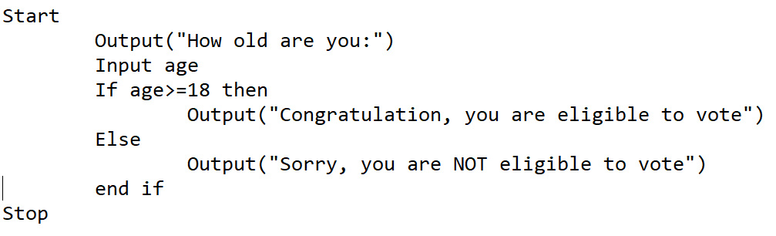
Making Decision (Cont_1)
Eligible to vote when turn 18
Program ask users enter his/her age and determine in he/she is able to vote. Draw flowchart for the below program

Slide 48
Repeating Instructions
Program in Figure 1-7 only works for one number
Not feasible to run the program over and over 10,000 times
Not feasible to add 10,000 lines of code to a program
Create a loop (repetition of a series of steps) instead
Avoid an infinite loop (repeating flow of logic that never ends)

Slide 49
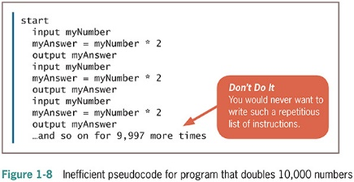
Repeating Instructions (continued -1)

Slide 50
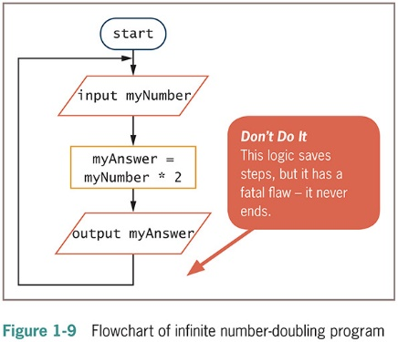
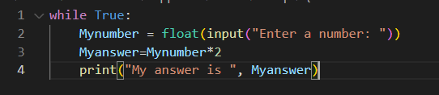
Repeating Instructions (continued -2)

Slide 51
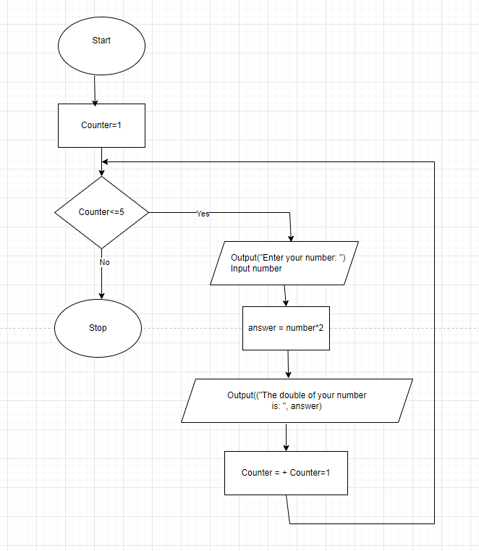
Using a Counter to End a Program
Loop with specified number of iterations
Initialize a Counter before entering the Loop
Testing the condition
Each iteration of the Loop: change value of the Counter
Start
counter = 1
While counter <=5
Output("Enter your number: ")
Input number
answer = number *2
Output ("The double of your number is: ", answer)
counter = counter +1
end while
Stop

Slide 52
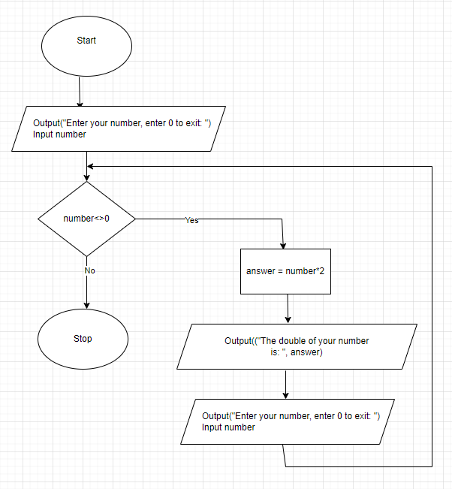
Using a Sentinel Value to End a Program
Loop with unspecified number of iterations
Testing the condition
Dummy value
Data-entry value that the user will never need
Sentinel value
eof (“end of file”)
Marker at the end of a file that automatically acts as a sentinel
Start
Output("Enter your number, enter 0 to exit: ")
Input number
while number <>0
answer = number *2
Output("Enter your number, enter 0 to exit: ")
Input number
end while
Stop

Slide 53
Understanding Programming and User Environments
Understanding Programming Environments
Text Editor is used to create simple text files
Integrated development environment (IDE) provides an editor, compiler, and other programming tools
Microsoft Visual Studio IDE
Understanding User Environments
Command line is a location on your computer screen at which you type text entries to communicate with the computer’s operating system
A graphical user interface, or GUI (pronounced gooey), allows users to interact with a program in a graphical environment

Slide 54
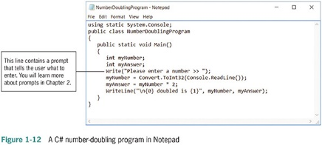
Understanding Programming Environments

Slide 55
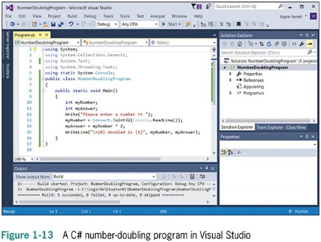
Understanding Programming Environments (continued -1)

Slide 56
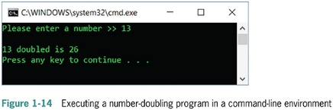
Understanding User Environments

Slide 57
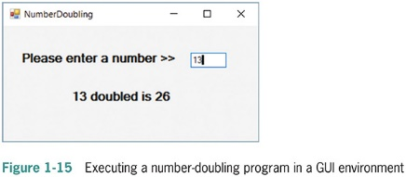
Understanding User Environments (continued -1)

Slide 58
Understanding the Evolution of Programming Models
People have been writing modern computer programs since the 1940s
Newer programming languages
Look much more like natural language
Are easier to use
Create self-contained modules or program segments that can be pieced together in a variety of ways

Slide 59
Understanding the Evolution of Programming Models (continued -1)
Major models or paradigms used by programmers
Procedural programming
Focuses on the procedures that programmers create
Object-oriented programming
Focuses on objects, or “things,” and describes their features (or attributes) and their behaviors

Slide 60
Summary
Hardware and software accomplish input, processing, and output
Logic must be developed correctly
Logical errors are much more difficult to locate than syntax errors
Use flowcharts and pseudocode to plan the logic
Avoid infinite loops by testing for a sentinel value
Use a text editor or an IDE to enter your program statements

Slide 61
Basic Introduction to Pseudo Code
Instructor: Hieu Tran

Slide 62
Basic Introduction to Pseudo Code
Pseudocode is an artificial and informal language that helps programmers develop algorithms
There are 3 basic elements in every program. They are
Input: End user enter input
Processing: Everything with calculation, formula
Output: Giving out the desired output

Slide 63
Simple example
Example: A shop owner, who sells balls, each for $5. You have to develop a program to ask the seller to enter how many balls he sell for one day; From that you have to give out the output with the money
Input: How many balls already be sold for today, use the variable with name balls to store the number of balls
Processing: Use the formula : Revenue = balls * 5
Output: Print out, how much money (Revenue) the shop owner get from selling balls for today

Slide 64
Develop program with Pseudo Code
Start
Input balls
Revenue = balls *5
Output Revenue
Stop

Slide 65

Make more sense with prompts
Start
Output “Enter number of balls sold for today”
Input balls
Revenue = balls *5
Output “Revenue for today is “ , Revenue
Stop

Slide 66
New Problems: Problem 1
1st: Now the shop owner want to change the price for each ball from $5 to $6, what you have to modify the program now?
Solution: Change the formula from : Revenue= balls *5 to Revenue = balls*6
Start
num balls
num Revenue
Output “Enter number of balls sold for today”
Input balls
Revenue = balls *6
Output “Revenue for today is “ , Revenue
Stop

Slide 67

New Problems: Problem 2
2nd: The shop owner want to have an option to enter the price of each ball to himself, so he is able to change the price by himself whenever he wants
Solution: User 1 more variable (price), and use input prompt to ask end-user to enter price
Start
num balls
num Price
num Revenue
Output “Enter number of balls sold for today”
Input balls
Output “Enter the price for each ball”
Input Price
Revenue = balls *Price
Output “Revenue for today is “ , Revenue
Stop

Slide 68
Pay attention to errors (syntax error and logic error)
Syntax error ---- program does NOT work until you fix it
For example: inconsistence in variable name (balls vs ball)
Start
Output “Enter number of balls sold for today”
Input balls
Revenue = ball *5
Output “Revenue for today is “ , Revenue
Stop

Slide 69
Pay attention to errors (syntax error and logic error)
Logic error ---- program does work but the output is not an expected output (example: Revenue = balls + 5 instead of Revenue = balls * 5)
Start
num balls
num Revenue
Output “Enter number of balls sold for today”
Input balls
Revenue = balls + 5
Output “Revenue for today is “ , Revenue
Stop

Slide 70

Conclusion --- convert pseudo code to real programming language
Pseudocode is an artificial and informal language that helps programmers develop algorithms. Once you understand pseudo code, you can easily convert it into real programming language
Start
num balls
num Price
num Revenue
Output “Enter number of balls sold for today”
Input balls
Output “Enter the price for each ball”
Input Price
Revenue = balls *Price
Output “Revenue for today is “ , Revenue
Stop

Slide 71
Basic Introduction to Python
Instructor: Hieu Tran

Slide 72
Python – Overview Working with Python IDLE and Visual Studio Code
Run python online
Download Python at https://www.python.org/downloads/
Working Python with interactive mode
Coding with IDLE editor
Download Visual Studio Code at https://code.visualstudio.com/
Install extension for Python in Visual Studio Code
More info: How to Run Python in Visual Studio Code on Windows

Slide 73
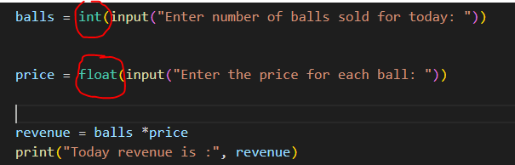
Python – Overview Input function
The input function always builds a string from the user’s keystrokes and returns it to the program
Strings that represent numbers must be converted from strings to appropriate number types
Two type conversion functions: int (for integers) and float (for floating-point numbers)

Slide 74
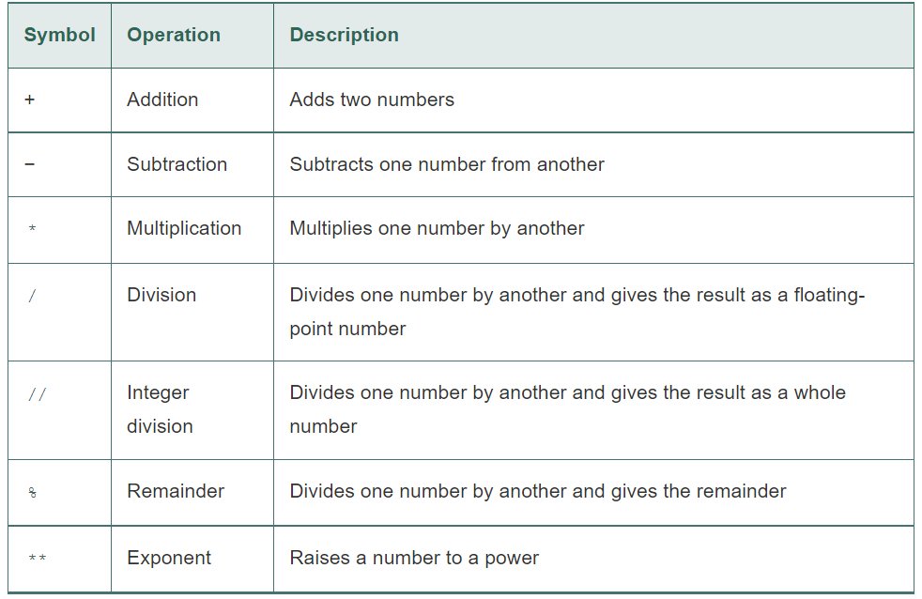
Python – Overview Perform Calculation

Slide 75

Python – Overview Print function, comments
Use print function to print out to screen
String concatenate
Comments are notes of explanation that document lines or sections of a program. Comments are part of the program, but the Python interpreter ignores them. They are intended for people who may be reading the source code.

